Slide 1
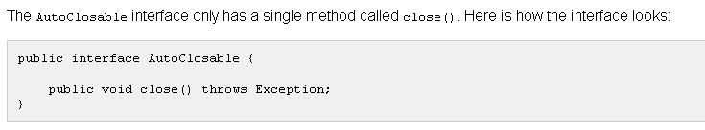
Custom AutoClosable Implementations

Slide 2
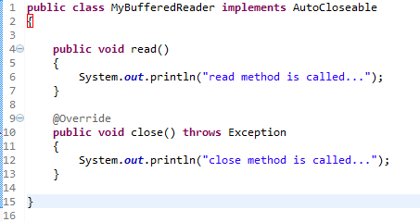
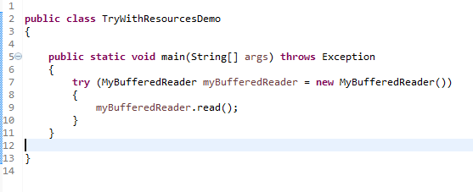
Custom AutoClosable Implementations
The try-with-resources construct does not just work with Java's built-in classes. We can also implement the java.lang.AutoCloseable interface in your own classes, and use them with the try-with-resources construct.
Any class that implements AutoClosable interface can be used with the try-with-resources construct.
try-with-resources is a quite powerful way of making sure that resources used inside a try-catch block are closed correctly, no matter if these resources are your own creation, or Java's built-in components.

